Slide 1


Predicting Liquor Sales Profit and post-Pandemic Business Analytics
Author: Razvan Nelepcu
Mentor: Dhiraj Khanna

Slide 2
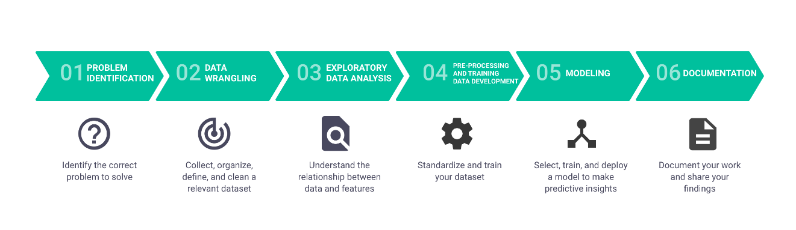
Project organization
The project follows all steps of Data Science workflow divided in the following major steps:
Problem Identification
Data wrangling
Exploratory Data Analysis
Pre-processing and training data development
Modeling
Documentation

Slide 3
Context
PROBLEM IDENTIFICATION
DATA WRANGLING
EDA
PRE-PROCESSING
MODELING
DOCUMENTATION
The Covid-19 pandemic is the major event of the 3rd Millennium that changed lives and businesses.
We know that some businesses went bankrupt or had to close their businesses overnight, such as bars, restaurant, hotels, or aviation. Some other flourished, such as online shopping, grocery stores or delivery services.
And nowadays more than ever we need data to understand how the pandemic impacted different parts of economy.
Our project will be directed on analyzing the spirits sales in Iowa since 2012 to present.

Slide 4

Problem statement
PROBLEM IDENTIFICATION
DATA WRANGLING
EDA
PRE-PROCESSING
MODELING
DOCUMENTATION
This project looks to resolve some issues that are of high importance for two distinct business entities: Iowa Department of Commerce, Alcoholic Beverages Division and Liquor Store Owners. These are the 3 Business Problems that we identified and that were solved with this project:
• Exploration on what was the impact of Covid-19 on the Alcoholic Beverages Industry.
• Cohort Analysis and Customer Segmentation using RFM(Recency, Frequency and Monetary value) and Unsupervised Learning
• Using time series analysis and predictions to predict profit for next month for Iowa Dept of Commerce from spirits.
For future work we also identified 2 other Business Problems using the same data:
• Storage capacity management exploratory analysis for Iowa Department of Commerce, Alcoholic Beverages Division.
• Lastly, we want to assist a hypothetical liquor store owner in Iowa in expanding to new locations throughout the state.

Slide 5
PROBLEM IDENTIFICATION
DATA WRANGLING
EDA
PRE-PROCESSING
MODELING
DOCUMENTATION
Data Collection and Organization
The main dataset used is the Iowa Liquor Sales database from Data.Iowa.gov.
It contains more than 24 million records of spirits purchase of Class “E” liquor licenses by product and date of purchase from January 1, 2012, to current, data provided and updated monthly by Iowa Department of Commerce, Alcoholic Beverages Division, each record with 24 descriptive columns as described in the figure below.
The data contains labels such as Invoice number, Store, Address, Zip Code, Geographical Location, beverage category, vendor name, Item Description, State Bottle Cost, State Bottle Retail, Bottles Sold and Sale.
The fact that the data is exhaustive for all the sales of this kind in the state of Iowa was a great statistical feature of our data because we were working with the whole population of sales of this category of alcoholic beverages and not with just a sample, which allowed us to create powerful business insights with great confidence levels.

Slide 6
PROBLEM IDENTIFICATION
DATA WRANGLING
EDA
PRE-PROCESSING
MODELING
DOCUMENTATION
Features exploration
To clean data, we need to explore data.
First, we used the describe method to explore both numerical and categorical data. This allowed us to see the range of values, the count of values, as well as the count of distinct values for categorical features.
To ensure data quality we had to make sure the features were matching. We had 3 features for which we also had numbers:
Store Name & Store Number
County Name & County Number
Category & Category number
Vendor Name & Vendor number
Item description & Item number
Form all these we had to make sure the pairings were unique.
Then we continued and explored the outliers of our data, with no significant findings

Slide 7
PROBLEM IDENTIFICATION
DATA WRANGLING
EDA
PRE-PROCESSING
MODELING
DOCUMENTATION
PREPARING OUR DATA INTO BUSINESS RELEVANT SUBSETS AND SAVING DATA
For each identified problem we selected the relevant features and for some we performed groupby methods. We identified 3 problems to be approached with our project and 2 Business problems for Future work. These are those tackled in this project:
Problem 1. Exploration on what was the impact of Covid-19 on the Alcoholic Beverages Industry
Problem 2. Cohort Analysis and Customer Segmentation using RFM(Recency, Frequency and Monetary value)
Problem 3. Using Time-Series to predict Profit for next month
And these are for future work:
Problem 4. Storage Capacity EDA
Problem 5.Assisting a hypothetical liquor store owner in Iowa in expanding to new locations throughout the state

Slide 8
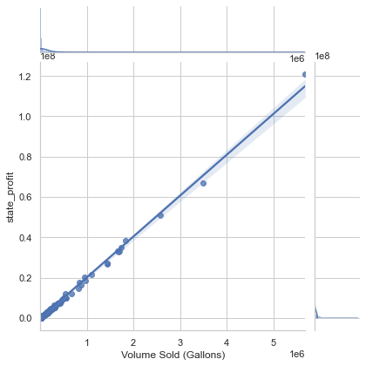
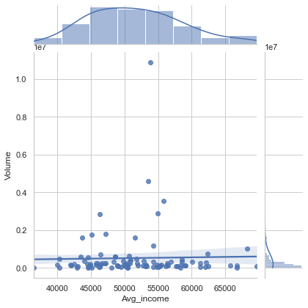
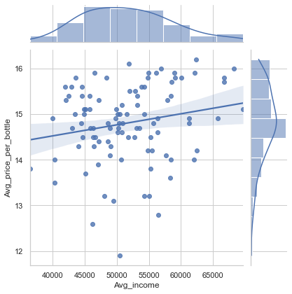
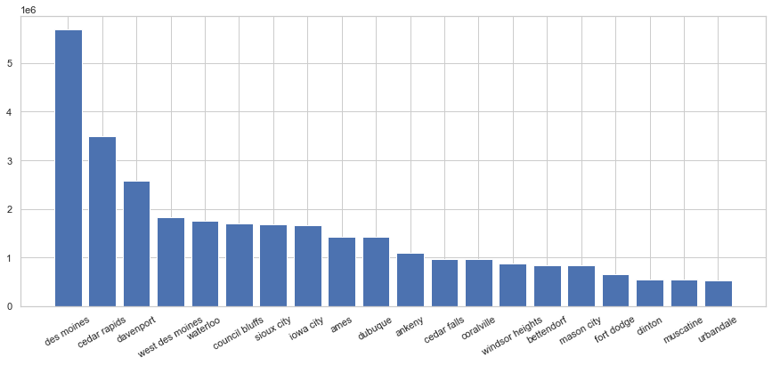
PROBLEM IDENTIFICATION
DATA WRANGLING
EDA
PRE-PROCESSING
MODELING
DOCUMENTATION
Univariate, bivariate and multivariate analysis
We also wanted to explore if the wealthier counties are buying more or if they are buying the more expensive drinks.

Slide 9
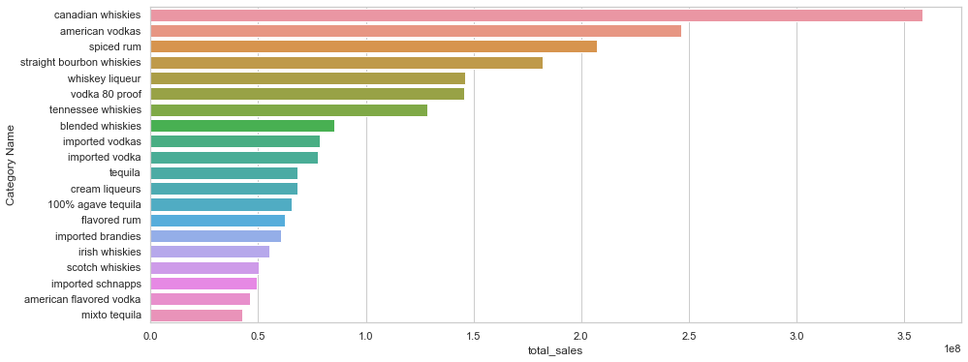
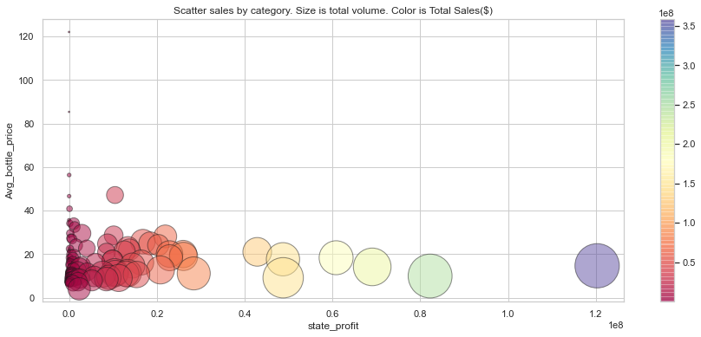
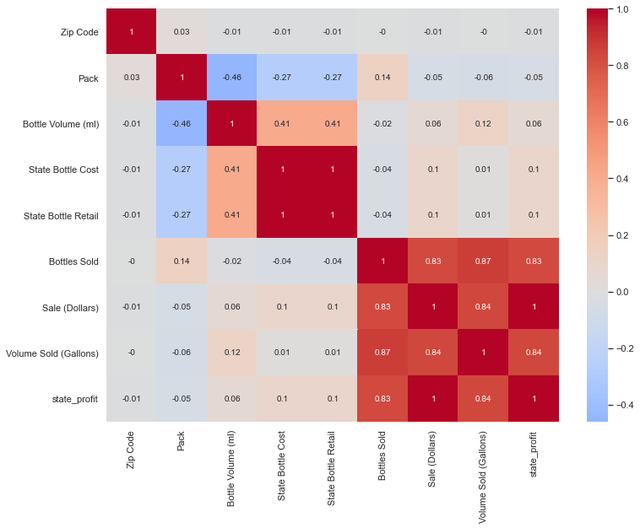
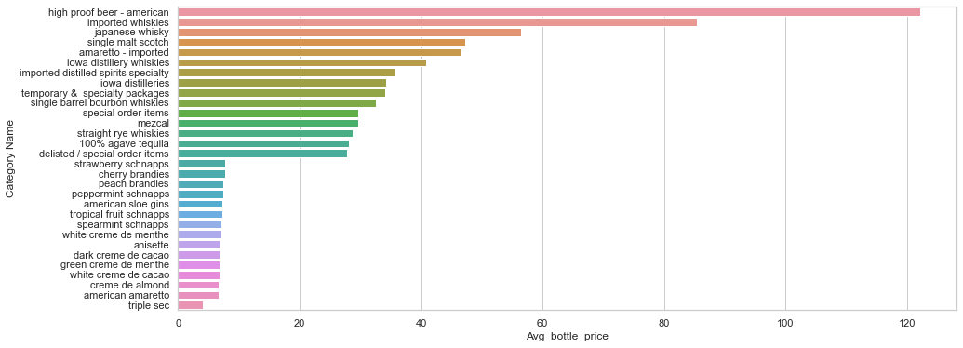
PROBLEM IDENTIFICATION
DATA WRANGLING
EDA
PRE-PROCESSING
MODELING
DOCUMENTATION
Univariate, bivariate and multivariate analysis
We also explored:
the average bottle price per category, ranking these by sales and cost and Volume sold.
a scatter plot of the categories with data regarding state
profit, average bottle price, total volume and total sales.
the heatmap of our numerical features correlations.

Slide 10
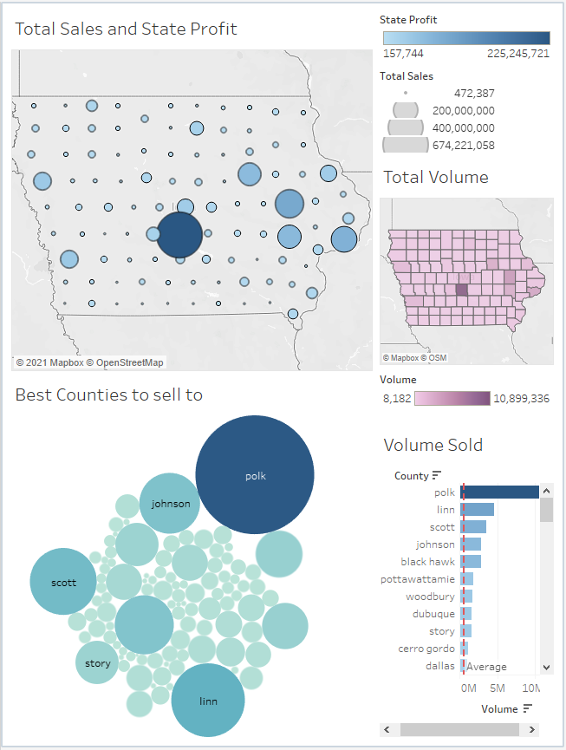
PROBLEM IDENTIFICATION
DATA WRANGLING
EDA
PRE-PROCESSING
MODELING
DOCUMENTATION
The impact of Covid-19 on the
Alcoholic Beverages Industry
We used Tableau to create two dashboard to help us visualize the data.
This is the link to the Tableau Public work: https://public.tableau.com/views/QuickEDA/Dashboard1?:language=en-US&:display_count=n&:origin=viz_share_link

Slide 11
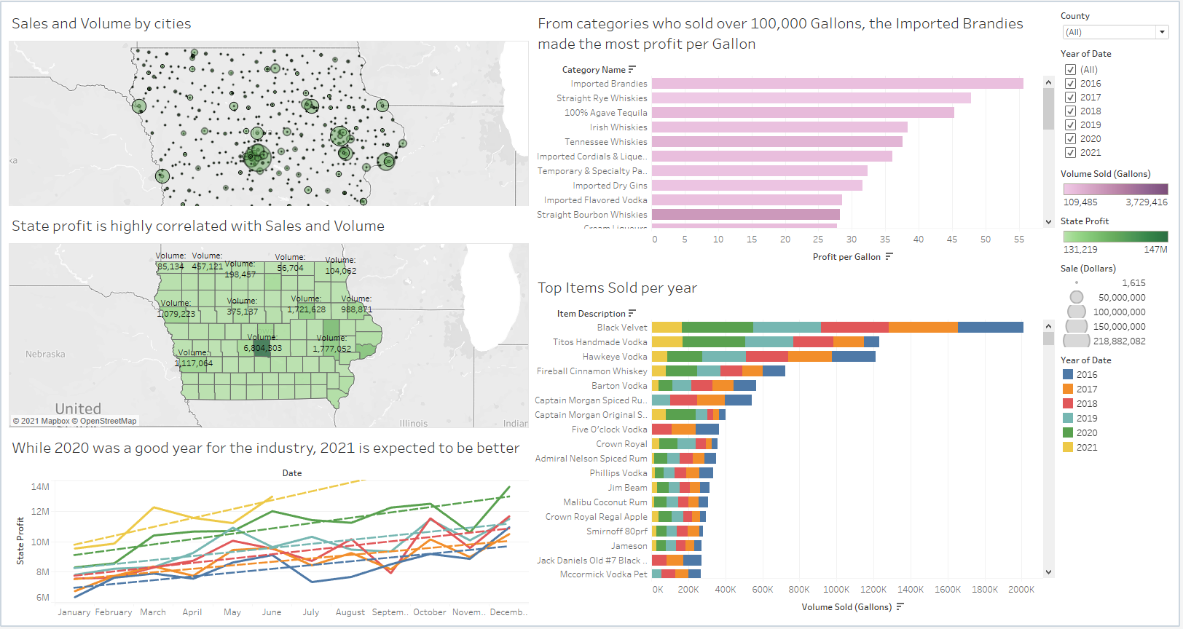

Slide 12
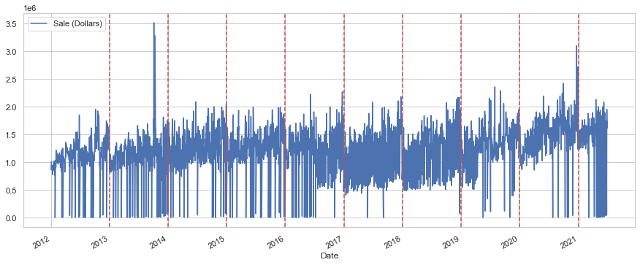
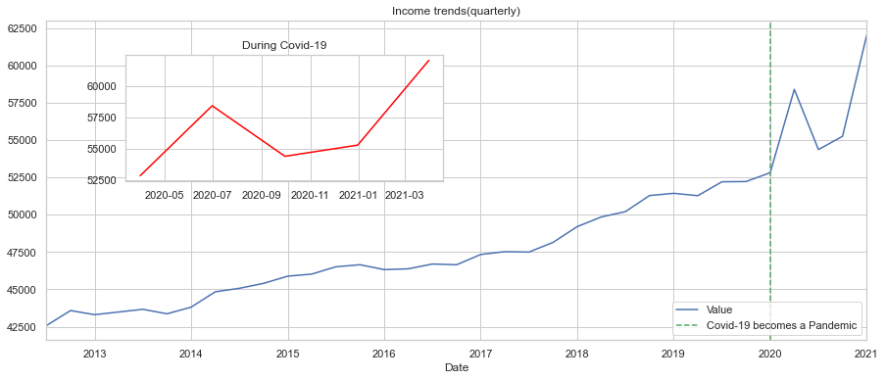
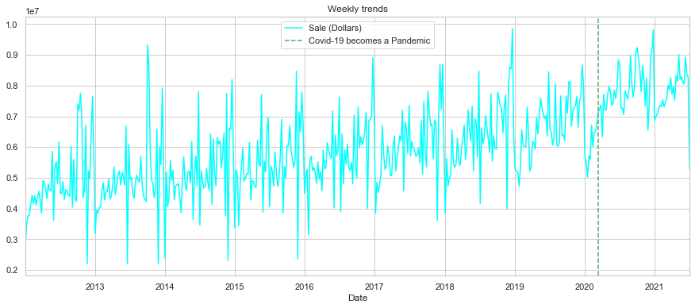
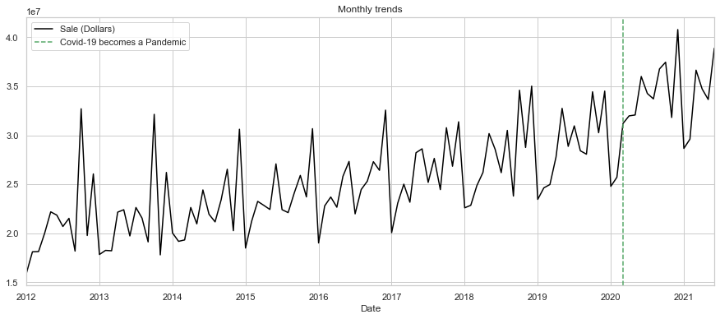
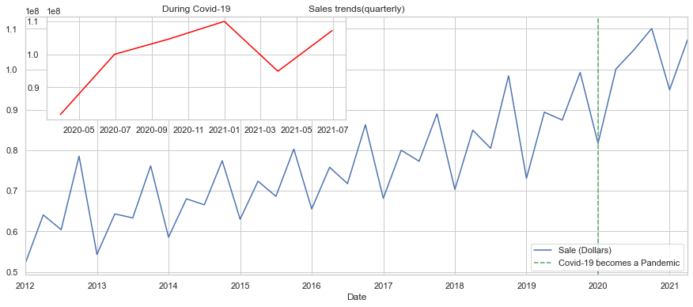
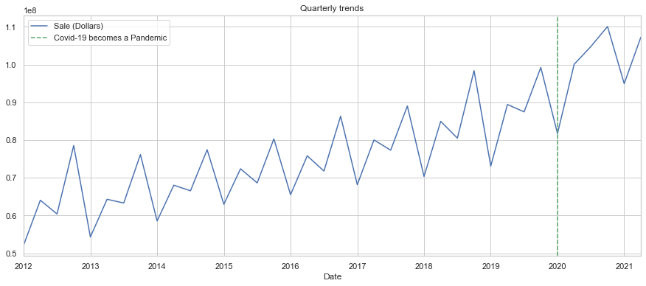
PROBLEM IDENTIFICATION
DATA WRANGLING
EDA
PRE-PROCESSING
MODELING
DOCUMENTATION
The impact of Covid-19 on the
Alcoholic Beverages Industry
We also aggregated our total Sales feature on days, weeks, month and quarters to visualize trends and seasonality.
To see if the trends in Sales might be dependent on any other than the Pandemic influence, we got some additional data, the quarterly income and the population growth.

Slide 13
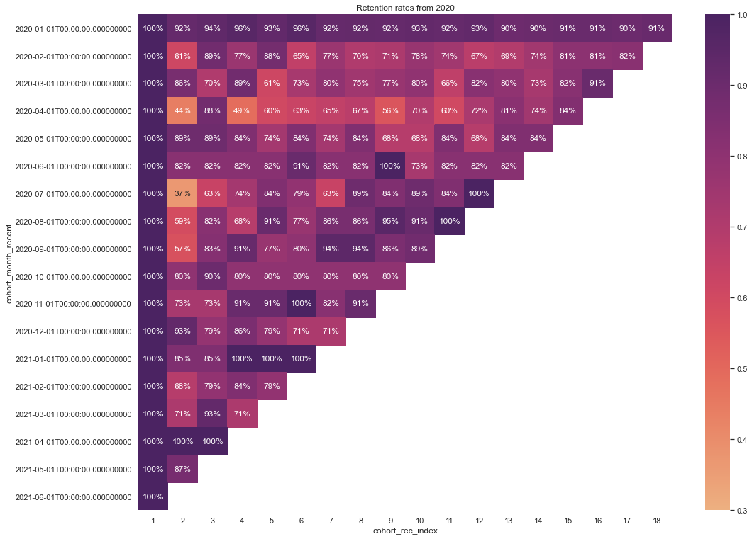
PROBLEM IDENTIFICATION
DATA WRANGLING
EDA
PRE-PROCESSING
MODELING
DOCUMENTATION
Pre-proccessing – cohort analysis
We began our analysis with a customer cohort Analysis. More precisely with a Store retention table, for data since 2020.
We can see that, unlike the retail industry where the retention rates are substantially lower, in this case the stores that are buying from the state department are more prone to order again every month.
We can see that for the months of July and August 2020, all the stores that made their first purchase in these 2-month ended up ordering again in June of 2021.

Slide 14
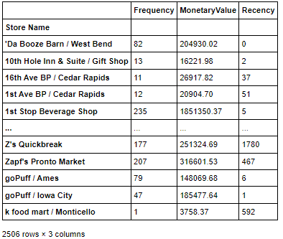
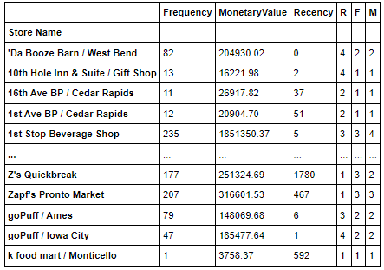
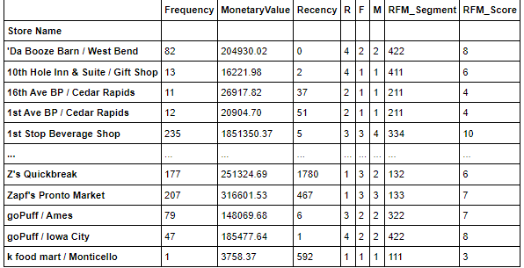
PROBLEM IDENTIFICATION
DATA WRANGLING
EDA
PRE-PROCESSING
MODELING
DOCUMENTATION
Pre-proccessing – Customer
Segmentation with RFM
This is a behavioral customer segmentation based on three metrics:
Recency(R)
Frequency(F)
Monetary Value(M)
The process of percentile grouping involves:
Sorting the customers based on each of the 3 metrics
Breaking customers into a pre-defined number of groups of equal size
Assign a label to each group
Building RFM segment and RFM score
For the RFM segment we will just concatenate the 3 metrics.
For the RFM score we will add the 3 metrics.

Slide 15
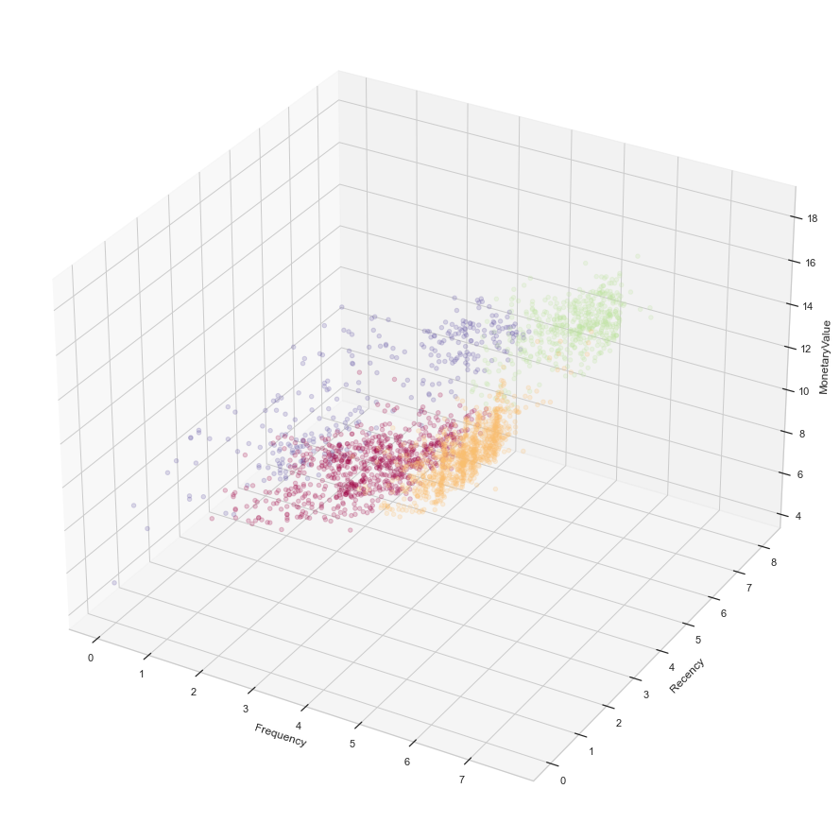
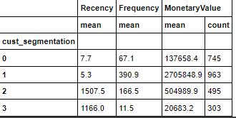
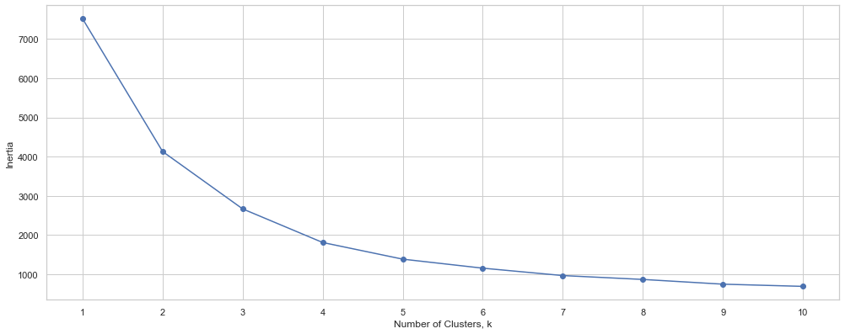
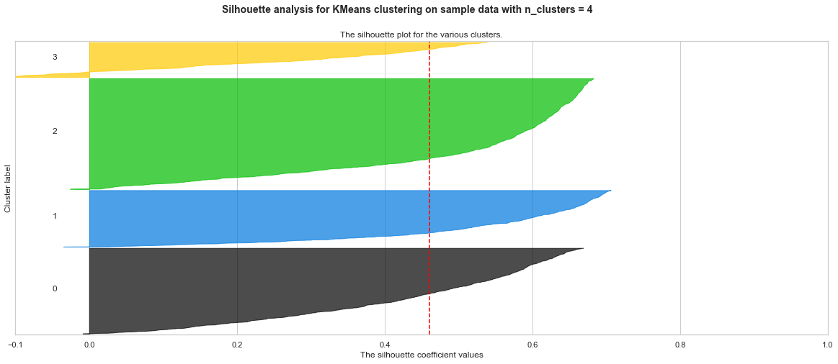
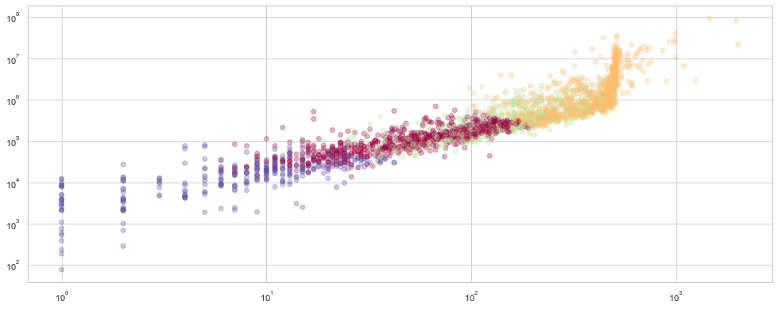
PROBLEM IDENTIFICATION
DATA WRANGLING
EDA
PRE-PROCESSING
MODELING
DOCUMENTATION
Customer Segmentation with RFM and
Unsupervised Learning Clustering
Using the RFM values we can furthermore create a clustering of similar Stores using Unsupervised Learning
As methods of choosing the optimal
K clusters we will use:
• Elbow method
• Silhouette scores and plots
We decided on 4 clusters.

Slide 16
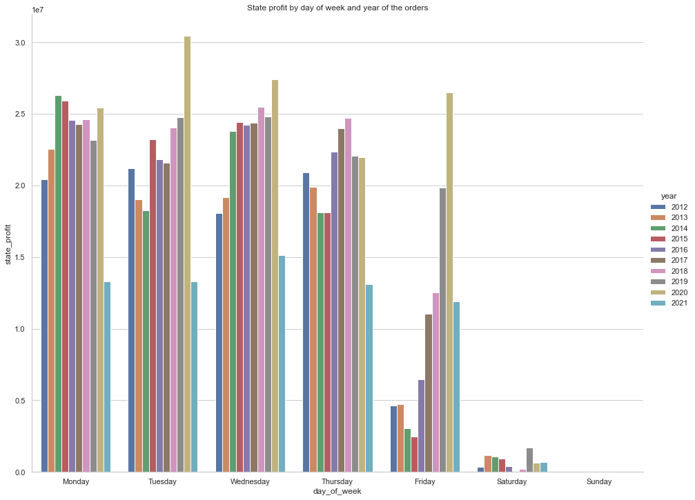
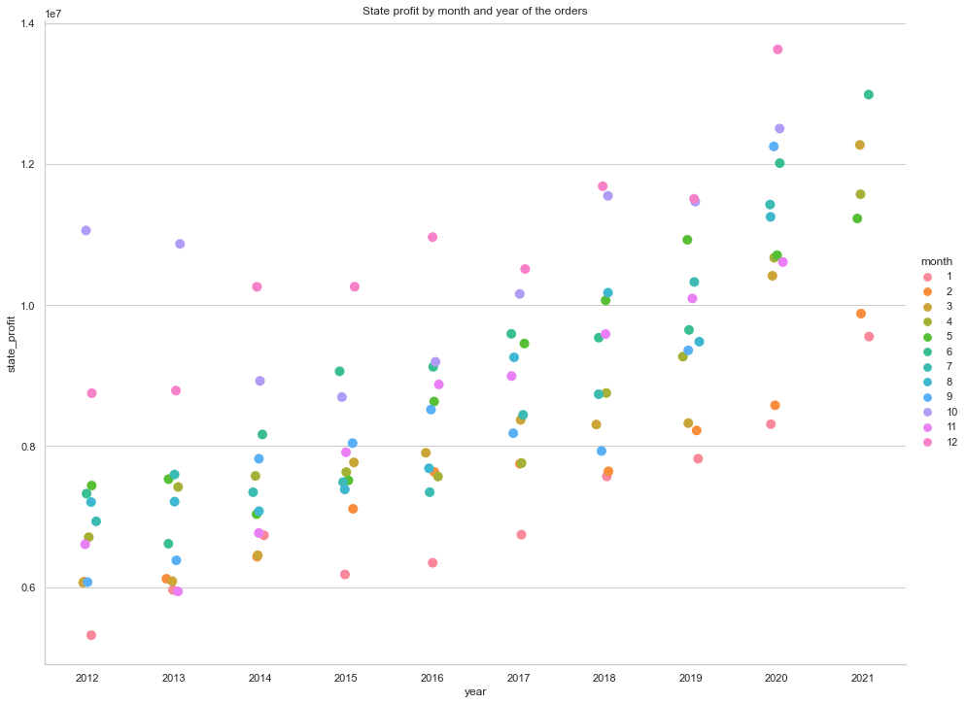
PROBLEM IDENTIFICATION
DATA WRANGLING
EDA
PRE-PROCESSING
MODELING
DOCUMENTATION
Time series Analysis
The main target and goal of our project is using time series analysis and predictions to
forecast Iowa's Dept. of Commerce profits from spirits Sales. We plan to follow a series of methods and tools to conduct the analysis, transformation and modeling of our data:
Time series decomposition
Trend
Seasonality
Noise(Residuals)
Stationarity
AC and PAC plots
Dickey-Fuller test
Choosing the metrics
RMSE
MAE
Models Tested
AutoRegressive model (AR 1)
BIC(Bayesian Information Criterion) adjusted AR model
Moving Average Model(MA)
Autoregressive Moving Average (ARMA)
Seasonal autoregressive integrated moving average (SARIMAX)

Slide 17
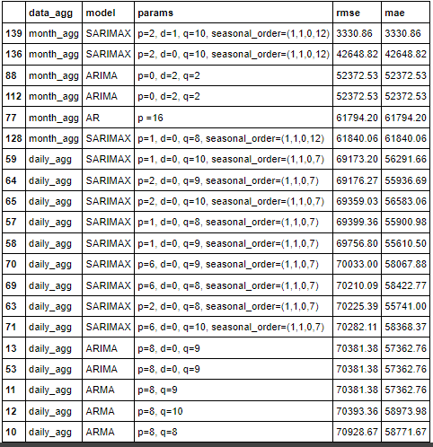
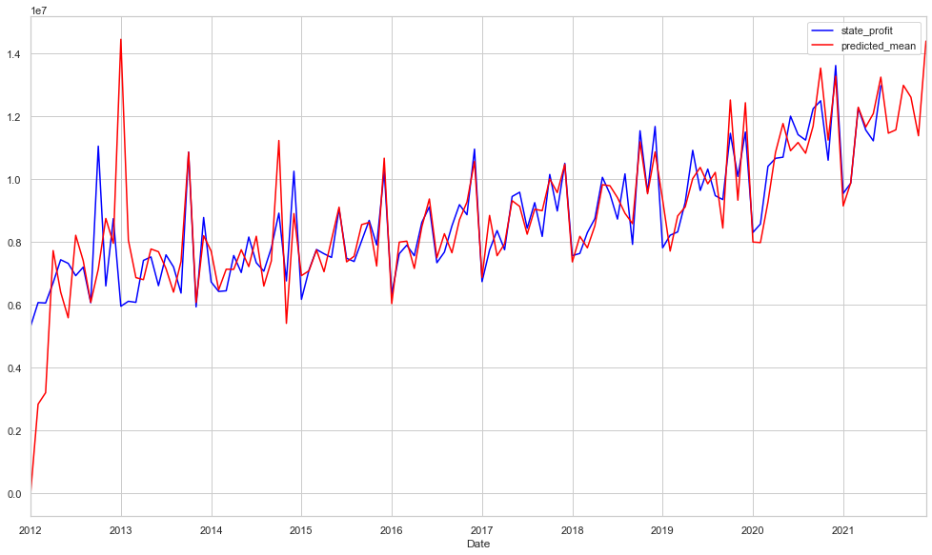
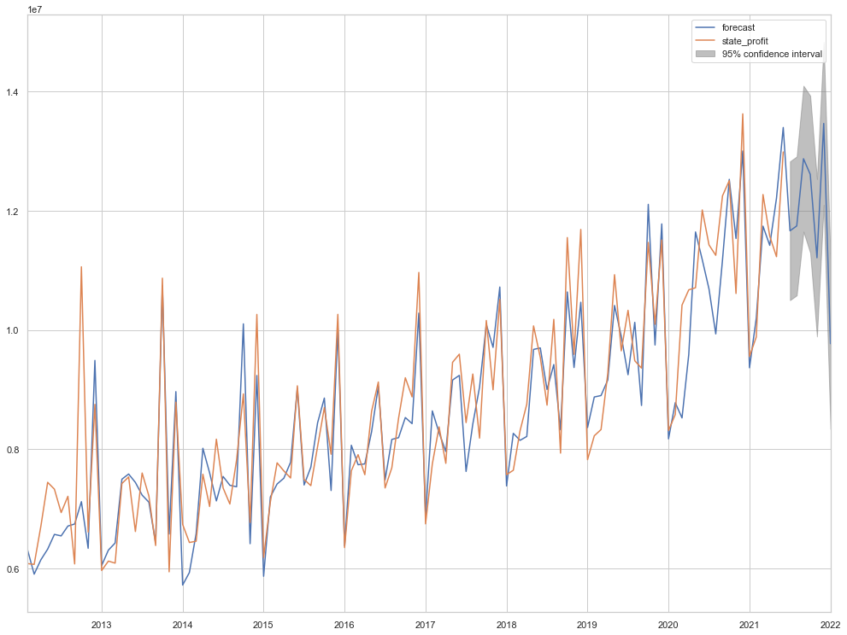
PROBLEM IDENTIFICATION
DATA WRANGLING
EDA
PRE-PROCESSING
MODELING
DOCUMENTATION
Modeling
We used the RMSE as the metric to classify the models. We also used the multitude of models with 2 different data: daily aggregations and Monthly aggregations.
This are the top 20 models with the highest scores on the Validation set.
Best model - SARIMAX with p=2, d=1, q=10, s=(1,1,0,12)
on monthly aggregated data
AR16 – on monthly aggregated data

Slide 18

PROBLEM IDENTIFICATION
DATA WRANGLING
EDA
PRE-PROCESSING
MODELING
DOCUMENTATION
Future work
For future work we still want to explore the 2 identified Business Problems – helping a store owner to pick a new location for a store so that he will maximize sales, and EDA on Storage Capacity.
Another aspect is that the data will become available for future testing and prediction.
Every month new data will be uploaded so we can use that to test our models predictions accuracies.

Slide 19

PROBLEM IDENTIFICATION
DATA WRANGLING
EDA
PRE-PROCESSING
MODELING
DOCUMENTATION
Recommendations
Ptofit per month is a very important metric for any company in every industry. Predicting the profit evolution allows companies to plan and make Business Operations decisions for the foreseeable future.
Future Profit per month is also an indicator of the value a company is having, and the potential growth. This will determine the need to invest in possible expansions:
Increase the number or quantities of available product to sell, along with investing in Marketing to attract new customers.
Expand to new locations within the same state on to other states.
The Covid-19 pandemic EDA and the RFM Customer Segmentations that we conducted are great tools for the Executive level to understand trends and customer base so they can make informed strategical business decisions.

Slide 20

Thank you!
Questions?

